Slide 1







Large Language Models as Configuration Validators​
Xinyu Lian, Yinfang Chen, Runxiang Cheng, Jie Huang,
Parth Thakkar, Minjia Zhang, Tianyin Xu
ICSE 2025 @ Ottawa
University of Illinois & Meta & xAI
ICSE 2025 @ Ottawa
lian7@illinois.edu
Notes:
Hello, everyone, I am Xinyu Lian, a first-year PhD student from UIUC, today I am going to present our paper large language models as configuration validators, it's a joint work of UIUC, Meta and XAI.

Slide 2
High Velocity of Configuration Changes
"The facebook.com’s various configurations are changed currently thousands of times a day. In 2014, thousands of engineers made live configuration updates to various parts of the site, which is even more than the number of engineers who made changes to Facebook’s frontend product code."
"Recovering from a configuration error on mobile devices is much harder [...] because developers don't have access to user's devices to identify the issues."
[1] Holistic configuration management at Facebook, SOSP, 2015.
[2] MobileConfig: Remote Configuration Management for Mobile Apps at Hyperscale, NSDI, 2024.
2
University of Illinois & Meta & xAI
ICSE 2025 @ Ottawa
lian7@illinois.edu
Notes:
As we all know, the software configuration change are undergoing in high velocity in production systems.
Our colleague Meta shared some data points that every day, in their backend systems, the developers make thousands of live config changes in production.
Recently, they said in their mobile app, thousands of engineers made configuration changes, which is even more than the number of engineers who made source code change. Moreover, Configuration errors has very severe consequence because recovering from a configuration error on mobile devices is much harder since developers don't have access to user's devices to identify the issues.

Slide 3








Challenges of Configuration Validation
Configuration
Lifecycles
Edit
Validation
Test
Review
Deploy
Diag.
Fix
Thousands per day
Pre-production
Post-production
Manual diff review is slow and error-prone.
Major engineering cost in writing validators or tests
Mature codebase still leave many parameters uncovered
3
University of Illinois & Meta & xAI
ICSE 2025 @ Ottawa
lian7@illinois.edu
Notes:
Every configuration deployment contains two main stages:
First, Pre-production– validating configs before they go live. Second stage is post-production – monitoring and rolling back bad configs.
And the Key challenges in today’s configuration validation workflow are two-fold:
Firstly, Manual inspection is slow and error-prone.
Second, it require High engineering overhead in writing validators or tests. And mature codebase still leave many parameters uncovered.

Slide 4






Can LLMs Help Configuration Validation?
Software Repository
Pre-Training Data
Document
Generalization
Reasoning
Fast response
Cost-efficiency
Q&A Website
Configuration
Lifecycles
Edit
Validation
Test
Review
Deploy
Diag.
Fix
Thousands per day
Pre-production
Post-production
4
University of Illinois & Meta & xAI
ICSE 2025 @ Ottawa
lian7@illinois.edu
Notes:
Since LLMs are trained on massive amounts of public data, including configuration data, such as configuration files in software repositories, configuration documents, Q&A websites for resolving configuration issues
LLMs show the ability of generalization and reasoning and can potentially “understand” configuration semantics. Moreover, LLM can generate the response in seconds and it is also cost-efficient compared to manual effort. However, it is still a question mark that can LLMs help configuration validations?

Slide 5
Can LLMs Help with Configuration Validation?
Let’s try GPT-3.5-Turbo.
Example 1: LLM catches an invalid port value.
<name>dfs.journalnode.httpaddress</name>
<value>0.0.0.0:80800</value>
<description>
The address and port the JournalNode HTTP server listens on.
</description>
...
Q:
Any mistakes in the above configuration file?
A:
The port number should be less than 65535.
5
University of Illinois & Meta & xAI
ICSE 2025 @ Ottawa
lian7@illinois.edu
Notes:
Let's try GPT-3.5-Turbo.
Here is one configuration file snippet, the first line is the parameter name, which is an address, the second line is the value of the parameter, followed by the description.
We ask GPT, are there any mistakes in the above configuration file?
The GPT can catches the invalid port value and give the right reason: the port number should be less than the upper bound.

Slide 6
Can LLMs Help with Configuration Validation?
Let’s try GPT-3.5-Turbo.
Example 2: LLM misses an invalid option.
<name>hadoop.ssl.hostname.verifier</name>
<value>STRICT_I8</value>
<description>
The hostname verifier to provide for HttpsURL-Connections. Valid values are DEFAULT, STRICT, STRICT_I6, DEFAULT_AND_LOCALHOST and ALLOW_ALL
</description>
...
Q:
Any mistakes in the above configuration file?
A:
The value of the parameter bloom.io.rate is wrong.
6
University of Illinois & Meta & xAI
ICSE 2025 @ Ottawa
lian7@illinois.edu
Notes:
On the other side , here we show another configuration file snippet, although in the description, it explicitly mentioned the set of valid values, and the given parameter value is not belong to this set, the GPT cannot detect it and hallucinate to another parameter, that reports the false alarm.

Slide 7
Contributions
Concept: A new direction of configuration validation using pre-trained large language models.
System: Ciri, an LLM-empowered configuration validation framework and an open platform for configuration research.
Study: An empirical analysis on the effectiveness of LLM-based configuration validation, and its design space.
Discussion: Opening up exciting future research directions.
Artifact: https://github.com/xlab-uiuc/ciri
7
University of Illinois & Meta & xAI
ICSE 2025 @ Ottawa
lian7@illinois.edu
Notes:
Serving as an open platform for configuration research
And we explore the design space
We hope it can open more research space.
We opensource our code and data, and we got all three badges.

Slide 8














Ciri: LLM-Empowered Configuration Validation
An extensible framework
Extensible configuration databases
Pluggable LLM backends
Prompt engineering
Few-shot learning
Retrieval-based augmentation
Result generation
Validation against hallucination
Voting against inconsistency
Shot File Selection
Configuration
Database
Valid configuration shot
Labeled Misconfiguration shot
Prompt Generation
Configuration Shot File
Config.
<name>io.bytes.per.checksum</name>
<value>4097</value>
Q:
Are there any mistakes...
Config.
shots
Config.
to validate
Ciri
Config.
A:
Answer...
Automatic Code Retrieval
Code
Retrieval
Code
Cache
Code Snippet
Query
Result
Result Generation
Validation
Voting
User
LLM
Ciri
Response
8
University of Illinois & Meta & xAI
ICSE 2025 @ Ottawa
lian7@illinois.edu
Notes:
It's an extensible framework, you can plug in your own database, and you can plug in your own model backend. It has two core components . one is prompt engineering, that we use few-shot learning and retrieval-based augmentation. And we also put some thoughts on the result generation, to deal with hallucination and inconsistency.

Slide 9
Prompt Engineering : Retrieval-Based Augmentation
Code snippets help LLMs understand configuration context
1. Provide parameter type information
Conf.setInt(“buffer.size”, Size1)
2. Highlight the semantic requirement
Conf.get(“address”).split(“:”)[1]
3. Show one valid value
“Kerberos”.equals(conf.get(“auth”))
9
University of Illinois & Meta & xAI
ICSE 2025 @ Ottawa
lian7@illinois.edu
Notes:
We have several designs in prompt-engineering, due to time limit, I will briefly take about retrieval-base augmentation. It is based on the idea that Code snippets help LLMs understand configuration context.
First, it can provide parameter the type information.

Slide 10
Result Generation: Validation Against Hallucination
The response needs to follow the rules:
If hasError is false, both errParameter and reason need to be empty.
If hasError is true, the errParameter and reason must be non-empty lists of equal length.
errParameter must not contain duplicate entries.
…
Structured format
Answer Template
{
"hasError": boolean,
"errParameter": [],
// parameters with errors
"reason": [],
// explanations for each error
}
Retry logic:
If a response violates any rule, Ciri automatically retries until the LLM returns a fully valid output.
In evaluation, 5% of responses violated the rules and were retried by Ciri.
10
University of Illinois & Meta & xAI
ICSE 2025 @ Ottawa
lian7@illinois.edu
Notes:
We also put some thought into result generation to address hallucination and inconsistency. Due to time constraints, I’ll briefly discuss validation against hallucination. We force Ciri to return output in the structured JSON format shown here, which makes it easy to parse and validate. The response must follow several rules—for example, if the LLM detects misconfigurations, it must list the parameters in error and their corresponding reasons, and these two lists must be of equal length. If any rule is violated, Ciri automatically retries the query until the LLM produces a fully valid output. In our evaluation, 5% of responses violated the rules and were retried by Ciri.

Slide 11
Evaluation Methodology
Dataset: A misconfiguration dataset collected from prior work with 51 real-world configuration-induced failures of 5 open-source projects.
Comparison
ConfMiner [1]: Learning configuration patterns from files and commits
Ctest [2]: Configuration testing
Metrics
# Correct detection: Successfully pinpoint the misconfigurations.
# False alarm: Flags parameters that are not actually buggy.
# Missed detection: Fails to detect any misconfiguration.
[1] Learning Patterns in Configuration, ASE, 2021.
[2] Testing Configuration Changes in Context to Prevent Production Failures, OSDI, 2020.
11
University of Illinois & Meta & xAI
ICSE 2025 @ Ottawa
lian7@illinois.edu
Notes:
The dataset we used in evaluation is a misconfiguration dataset collected from prior work with 51 real-world configuration-induced failures of 5 open-source projects. And we compare with ConfMiner and Ctest. Confminer learns configuration patterns form files and commits. And Ctest is a configuration testing technique. We measure performance using three metrics. First is number of correct detection, which is the number of detection where it can successfully pinpoint the misconfigurations. Next is the number of false alarm and number of missed detection, where it fails to detect any misconfigurations.

Slide 12
Ciri can detect real-world misconfigurations
F
Few-shot learning
Code augmentation
Technique | # Correct detection | # False alarm | # Missed detection | Runtime
Ciri (Claude-3-Opus) | 45 (88.2%) | 1 | 5 | 2—60 sec
Ciri (GPT-4-Turbo) | 41 (80.4%) | 2 | 8 | 15-40 sec
Ciri (CodeLlama-34B) | 39 (76.5%) | 1 | 11 | 30-70 sec
ConfMiner | 27 (52.3%) | N.R | N.R. | N.R
Ctest | 41 (80.4%) | N.R. | N.R. | 20-230 min
Ciri outperform ConfMiner and matches or exceed Ctest’s detection ability.
Ciri delivering feedback in tens of seconds rather than minutes or hours.
12
University of Illinois & Meta & xAI
ICSE 2025 @ Ottawa
lian7@illinois.edu
Notes:
Next, I have some good news—and some bad news.
the good news is that the Ciri can perform very well in detecting the misconfigurations.
In the table we show the performance of Ciri with three LLM backend, Claude, GPT ad CodeLlama. Compare against confminer and Ctest. last column is the end-to-end detection runtime.
We have two conclusions. First is Ciri xxx
And we have more results that we put on the right corner of the slide, due to time limit, please refer to our paper for details.

Slide 13
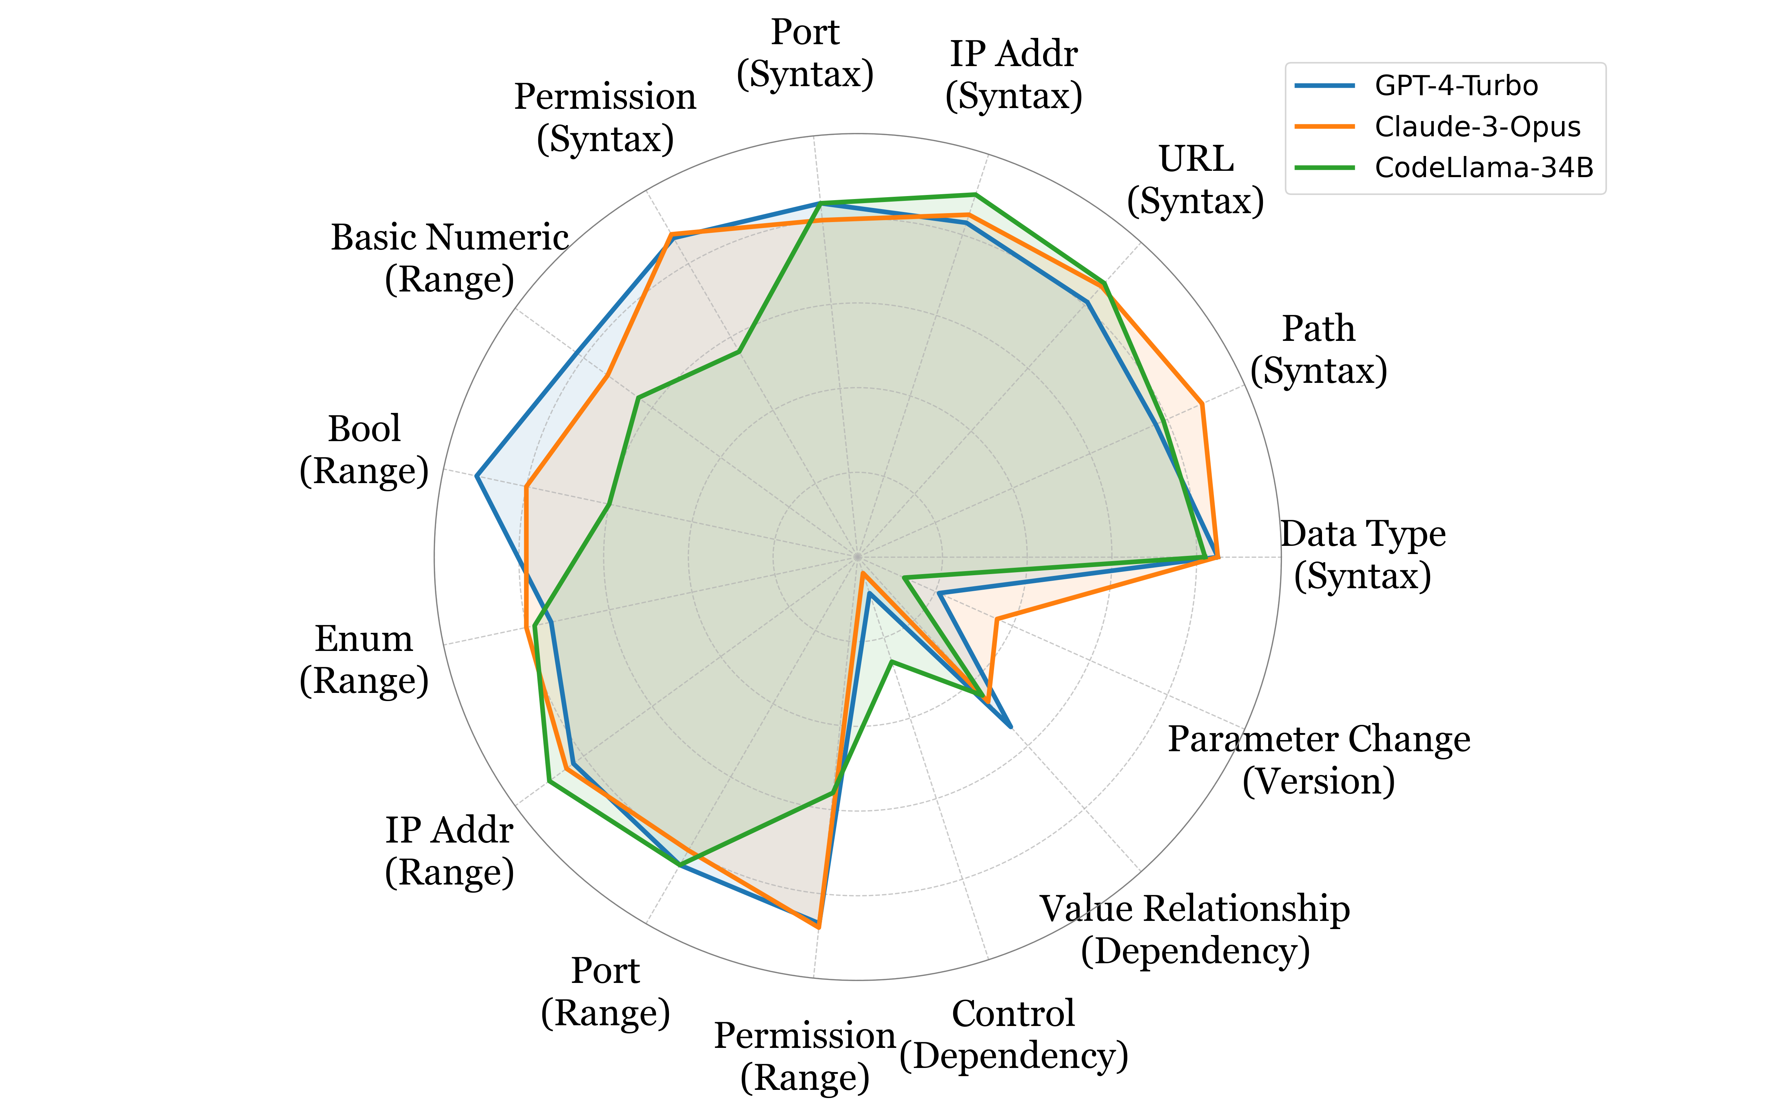



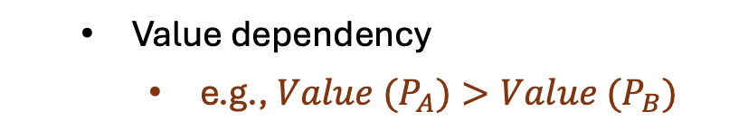
Ciri faces multiple challenges
F
LLM gives misleading reasons
LLM are bias to parameters
LLMs are limited in detecting misconfigurations of dependency and version violations type.
Value dependency
e.g., ${Value (P}_{A})>Value (P_{B})$
Control flow dependency
${\text{e}\text{.}\text{g}\text{.,} P}_{A} when P_{B} =V$
Version (Parameter Change)
e.g., $P_{A} is removed$
13
University of Illinois & Meta & xAI
ICSE 2025 @ Ottawa
lian7@illinois.edu
Notes:
And the bad news is Ciri faces multiple challenges. One of the challenges is Ciri perform not well on certain types of misconfigurations. achieve strong performance on most categories, they notably underperform on three specific types.

Slide 14
Future Research Directions
Integrating LLMs with advanced configuration analysis
Combining LLMs with code-based configuration analysis
Using advanced prompting techniques
e.g., Chain-of-Thoughts, multi-agent
Generating configuration tests or validation code
Can address environment-specific misconfigurations
Fine-tuning LLMs for configuration
14
University of Illinois & Meta & xAI
ICSE 2025 @ Ottawa
lian7@illinois.edu
Notes:
Ciri is just the first work towards this direction. And it will open exciting future directions.

Slide 15
Conclusions
Many more results in the paper!
Concept: A new direction of configuration validation using pre-trained large language models.
System: Ciri, an LLM-empowered configuration validation framework and an open platform for configuration research.
Study: An empirical analysis on the effectiveness of LLM-based configuration validation, and its design space.
Discussion: Opening up exciting future research directions.
Artifact: https://github.com/xlab-uiuc/ciri
15
University of Illinois & Meta & xAI
ICSE 2025 @ Ottawa
lian7@illinois.edu
Notes:
In this paper, we present a first analysis on the feasibility and effectiveness of using LLMs such as GPT and Claude for configuration validation. As a first step, we empirically evaluate LLMs in the role of configuration validators, without additional fine-tuning or code generation.

Slide 16

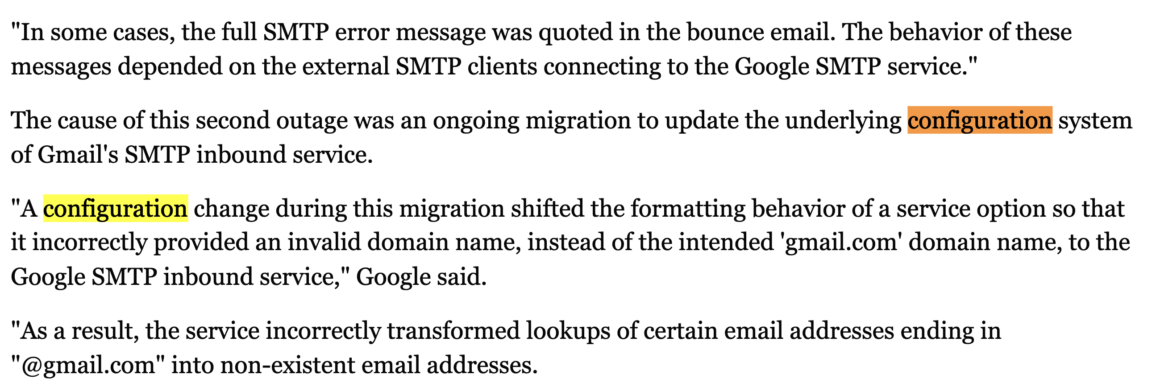
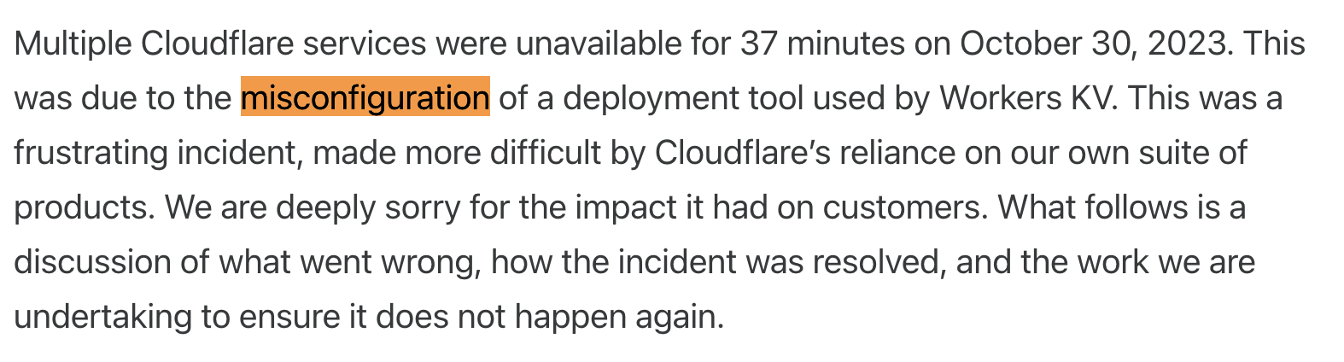
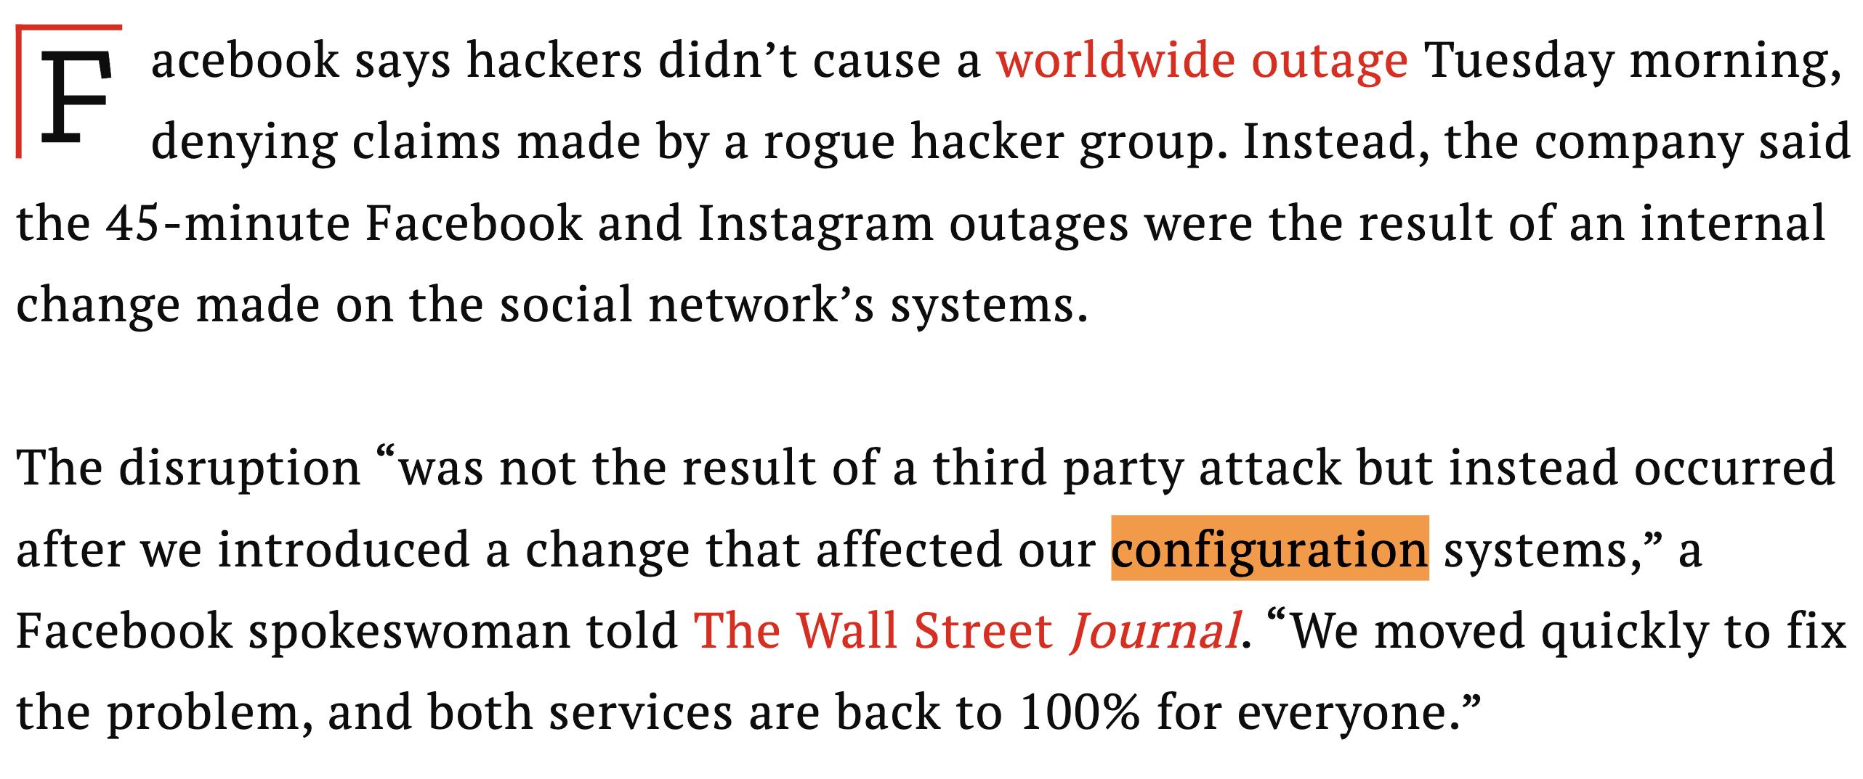
High Velocity of Configuration Changes
16
University of Illinois & Meta & xAI
ICSE 2025 @ Ottawa
lian7@illinois.edu
Notes:
In big companies, thousands of configurations are deployed daily, and misconfigurations are a leading cause of software failures in production systems, putting both reliability and availability at risk.
Large companies such as Cloudflare, Facebook and Google got into big issues due to misconfigurations.
Therefore, ensuring the correctness of configuration is important

